Slide 1
Robot Framework

Slide 2
Introduction
Used for Acceptance Testing(UAT).
It utilizes Keyword-driven testing approach.
It compatible for both python and java.
Not much programming is required.

Slide 3
Installations
Install Python latest version
Install PyCharm IDE
Install Selenium
Install Robot Framework
Install Robot Framework-SeleniumLibrary

Slide 4
Structure of Framework
Step 1: Settings (Here we will import required library’s).
Step 2: Variables (Here we will declare variables which are repeatedly used and encapsulated links like Application URL, Browser).
Step 3: Testcases (Here we will write the testcases and functionality Testing) is done.
Step 4 : Keywords(Here we will declare pre-define and user-define keywords)

Slide 5
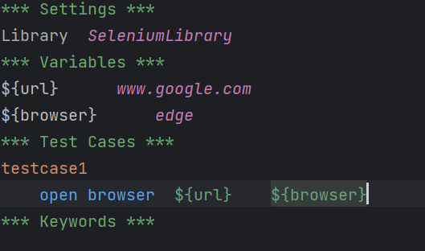
Syntax for Structure of Robot Framework

Slide 6
Input text Box
Testing the input text box

